Slide 1
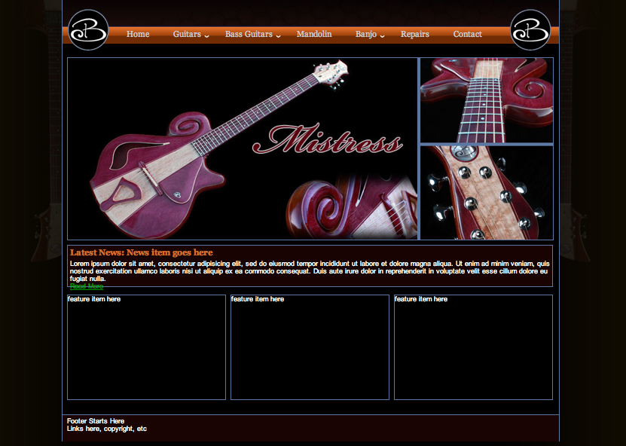
Notes:
Full Website Navigation: Toolbar
Home
Guitars
-Models (Silhouette Page)
-Roller
-Imperial
-Mistress
-Dark Horse
-Hornet
-Castle Wave
- Guitar Themes
-Natural
-GhostRider
-HeadHunter
-Chameleon
-House
-Nashville
-Custom
Basses
-Models (silhouette page)
-Roller
-Mantis
-Waterfall
-Bass Themes
-Native
- LoRyder
-Cosmic
-HighRoller
-Custom
ECL Instruments
Ordering
-Availible Now
Resources
-Color samples- photo gallery where we can up load and label pics
- Wood samples -photo gallery where we can up load and label pics
-About Us
-Repairs
-Becker Artists (we will b adding more artist, If there is an easy way for us to add to this from time to time that would be great)
I would like to put a pic album and a spot for youtube links that we can update on the artists page
-Contact can we get new email addresses..ex guitars@beckerguitars.com, repairs @beckerguitars.comn etc
We love the slide show of the instruments.
under the latest news can you put Welcome to ElectriCandyLand ( capital ECL)
for the 3 boxes: can we make them photo galleries, I am open to ideas on these boxes
Availible now
2. Artists
3. General shop photo gallery

Slide 2
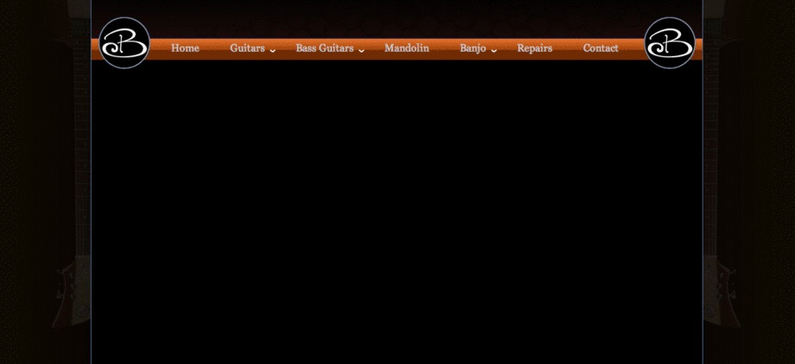
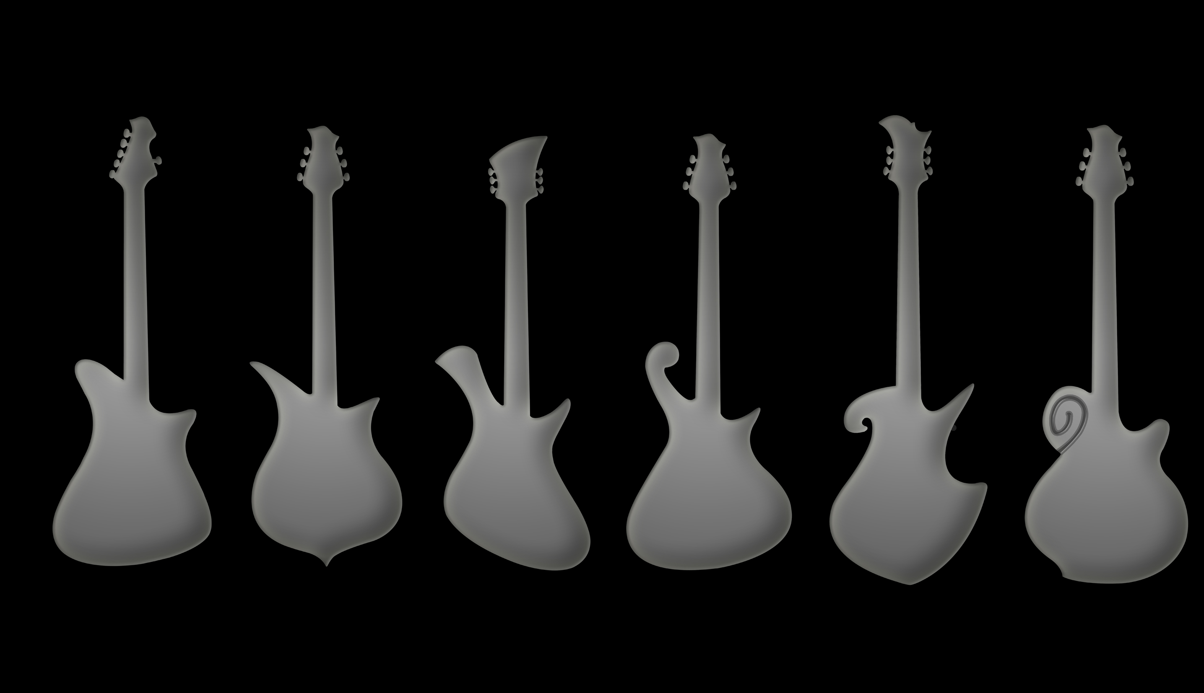
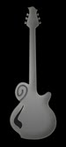
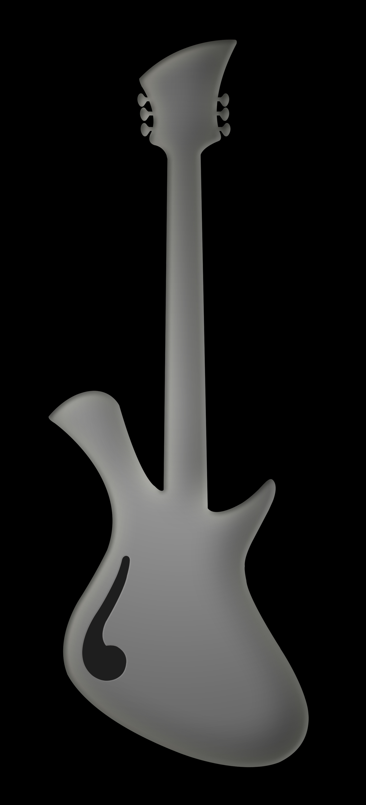
Guitar Models
Home->Guitars->Models
Clicking model name or picture should take to specific model page with links to available themes and an Order Now button to begin “shopping cart” experience a la mac’s website. Order now should take the user to a page for that model with all available themes listed with prices for each and drop-down options where applicable. See page of ordering info and specs for details. The shopping cart format would be tough to create on powerpoint, word, etc so I’m going to give you guys all the info we need and leave the actual page building up to the developer.
The silhouette pics are in a folder called model silhouetts
Roller
Dark Horse
Hornet
Imperial
Castle Wave
Mistress
Notes:
There is a silhoutte folder with the individual pics

Slide 3
Roller
Home->Guitars->Models->Roller
Available in:
Natural Theme
GhostRider Theme
HeadHunter Theme
Chameleon Theme
House Theme
Nashville Theme
Custom
Notes:
Put a larger the silohouette pic as the main pic and the theme pics smaller.
We have a pic of an instrument done up in each theme….
Natural- bass natural 1
GhostRider-P90GR1
HeadHunter- Redburst Headhunter 1
Chameleon-Darkhorse chameleon 1
House- House roller 1
Nashville- Nashville 1
Custom- MotherEarth 1

Slide 4
Imperial
Home->Guitars->Models->Imperial
Available in:
Head Hunter Theme
Chameleon Theme
House Theme
Nashville Theme
Custom
Notes:
Put a larger the silohouette pic as the main pic and the theme pics smaller.
We have a pic of an instrument done up in each theme….
HeadHunter- Blackberr headhunter1
Chameleon-Darkhorse chameleon 1
House- house imperial 1
Nashville- Nashville 1
Custom-King 1

Slide 5
Mistress
Home->Guitars->Models->Mistress
Available in:
Head Hunter Theme
Chameleon Theme
House Theme
Nashville Theme
Custom
Notes:
Put a larger the silohouette pic as the main pic and the theme pics smaller.
We have a pic of an instrument done up in each theme….
Natural- bass natural 1
HeadHunter- Blackberry headhunter1
Chameleon- darkhorse 1
House- Purple Mistress 1
Nashville- Nashville 1
Custom- Zebra mistress2

Slide 6
Dark Horse
Home->Guitars->Models->Dark Horse
Available in:
Head Hunter Theme
Chameleon Theme
House Theme
Nashville Theme
Custom
Notes:
Put a larger the silohouette pic as the main pic and the theme pics smaller. Can we add captions to the smaller pics.
We have a pic of an instrument done up in each theme….
Natural- bass natural 1
HeadHunter- Blackberr headhunter1
Chameleon-Darkhorse chameleon 1
House- house imperial 1
Nashville- Nashville 1
Custom-King 1

Slide 7
Hornet
Home->Guitars->Models->Hornet
Available in:
Head Hunter Theme
Chameleon Theme
House Theme
Nashville Theme
custom
Custom Purpl hornet
Notes:
Put a larger the silohouette pic as the main pic and the theme pics smaller. Can we add captions to the smaller pics.
We have a pic of an instrument done up in each theme….
HeadHunter- Blackberr headhunter1
Chameleon-Darkhorse chameleon 1
House- purple hornet1
Nashville- Nashville 1
Custom-westernred hornet1

Slide 8
Castlewave
Home->Guitars->Models->Castlewave
Available in:
Head Hunter Theme
Chameleon Theme
House Theme
Nashville Theme
Custom
Notes:
Put a larger the silohouette pic as the main pic and the theme pics smaller. Can we add captions to the smaller pics.
We have a pic of an instrument done up in each theme….
Caption
HeadHunter- Blackberr headhunter1
Chameleon-Darkhorse chameleon 1
House- house imperial 1
Nashville- Nashville 1
Custom-King 1

Slide 9
Guitar Themes
Home->Guitars->Themes
We offer our models in a variety of themes, all with different specifications, price levels, and options. Please refer to models pages to see which themes are available for each model. We currently offer the following themes: (NOTE: these should all be links)
Natural
GhostRider
HeadHunter
Chameleon
House
Nashville
Custom
Each individual theme page should have several series of thumbnails for each instrument. We will be adding to this as we finish guitars
Notes:
Pic for each theme
Ghost Rider-P90 GR 1.jpg
HeadHunter-redburst headhunter1
Chameleon-Darkhorse chameleon 1
House-house Imperial 1
Nashville-Nashville 1
Custom-King 1

Slide 10
The Natural
Home->Guitars->Themes->Natural
Shape Available: Roller
Finish: Oil
Body: Mahogany
Neck: Mahogany, neck-through 24.625” scale
Headstock: Matched to body
Fretboard: Bloodwood, purpleheart, ziricote, or cocobolo, 24 frets
Electronics: 2 humbuckers, Master Volume, Master Tone, 3-way switch
Hardware: Chrome, tune-o-matic bridge, stop tailpiece
Exotic wood hardware (pickup rings, knobs, bridge, and tailpiece) add $500
Our natural series of instruments is our most simplified theme. These instruments emphasize the natural beauty of mahogany bodies and through-necks along with exotic fretboards and natural oil finishes. For another dimension of elegance, they are available with matching wood hardware.
Notes:
*eventually when we finish the instruments there will be 4 Roller guitar photo albums, using bass pics for now
Photo albums caption
natural mantis 1-7 Shown: Native Mantis bass
natural bass 1-6 & 8 Shown: Native Twiggler bass

Slide 11
GhostRider Theme
Home->Guitars->Themes->Ghostrider
Shape Available: Roller
Finish: Satin Lacquer
Color options for mahogany GhostRiders: Black Cherry, Natural, Chestnut Burst, Kiwi Green, or Plum
Color options for alder GhostRiders:: Black Cherry, Sea Burst, Green Burst, Natrual, or Black
Body: Mahogany or Alder
Neck: Mahogany (for mahogany body) or Maple (for Alder body), neck-through 25” scale
Headstock: matched to body
Fretboard/Pickguard: Bloodwood, Purpleheart, Ziricote or Cocobolo : 24 frets + stainless zero Fret
Electronics:
Two Lindy Fralin hot humbuckers with two volume and two tone controls, two coil cuts and a three-way switch
Two P90s with master volume, master tone, and a three-way switch
Hardware: Chrome, tune-o-matic bridge, stop tailpiece
Price: Roller $2800
Our GhostRider takes the Roller shape and applies a matching exotic fretboard , pickguard and headplate. GhostRiders feature a vibrant satin lacquer finish available in a variety of bursts or solid colors as well as natural
Notes:
*please make it so that we will be able to change or add to the specs and options
*eventually there will be many different GhostRider photo albums. We only have 1 completed so far
Photo albums caption
P90GR 1-6 Mahogany P90 GhostRider finished in BlackCherry

Slide 12
HeadHunter Theme
Home->Guitars->Themes->Head Hunter
Our HeadHunter themed guitars begin with the classic combination of mahogany and highly figured curly maple, but feature our own designs and gorgeous burst finishes. We offset the rich colors of our finishes with the simple beauty of all chrome hardware and an ebony or zircote fretboard and headstock. These guitars are a truly refreshing take on a classic style.
Shapes Available: Any
Finish: high gloss burst
-color options: BlackCherry Burst, Greenburst, Blueberry burst, Blackberry burst, Honey Nut burst, Seaburst, Chestnut burst, Natural
Body: Mahogany w/Maple top
Chambered w/F hole add $300
Neck: Mahogany, neck-through 24.625 scale
Headstock : Ebony or Ziricote
-Curley Maple bursted headplate add $150
Fretboard: Ebony or Ziricote with matching binding: 24 frets+Stainless zero fret
Electronics: two humbuckers with two volume and two tone controls with a three-way switch
- with 2 Lyndy Fralin hot humbuckers with coil taps add $100
Hardware: chrome, tune-o-matic bridge, stop tailpiece, knobs and pickup rings
Woodpack (Ebony/Ziricote pickup rings, bridge, tailpiece, and knobs) add $500
Price: Roller $3600
DarkHorse $3800
Imperial $3800
Castlewave$4000
Hornet(chambered with f hole) $4000
Mistress (chambered with f hole) $4200
Notes:
*eventually there will be many different HeadHunter photo albums.
Photo Album caption
Blackberry HeadHunter 1-7 Imperial HeadHunter finished in BlackBerry burst
MIDI Castlewave 1-7 CastleWave HeadHunter finished in BlueBerry burst witrh midi
Redburst HeadHunter 1-8 Roller HeadHunter Finished in BlackCherry burst chambered with f hole
Stormburst Roller 1-7 Roller HeadHunter with a custom finish with woodpack hardware

Slide 13
Chameleon Theme
Home->Guitars->Themes->Chameleon
Our Chameleon theme focuses on showing the beauty of some of the finest exotic woods available. The design behind our Chameleon series uses bookmatched or three-piece exotic wood tops with matching wood knobs, bridges, tailpieces, pickup rings,fretboards, and headstock veneers to blend all of the instrument’s components into the look of one beautiful piece of continuous wood. In order to preserve the beauty of these woods, natural finishes are used.
Shapes Available: All
Finish: natural high gloss
-availible in satin or hand rubbed oil
Body: Mahogany
Top: Bookmatched or three-piece Bloodwood, Purpleheart, Ziricote, or Cocobolo
Neck: Unaccented Mahogany or Maple, neck-through 25” scale
Headstock: matched to top
Fretboard: matched to top :24 frets +stainless zero fret
Electronics:
Two humbuckers with two volume and two tone controls and a three-way switch
Two P90s with two volume and two tone controls and a three-way switch
Hardware: matched wood hardware
Price: Roller $4500
DarkHorse $4500
Imperial $4700
Castlwave $4700
Hornet $ 4900
Mistress $ 5000
Notes:
*eventually there will be many different Chameleon photo albums. We only have 1 pic to use at the moment
Pic
Darkhorse chameleon 1

Slide 14
House Theme
Home->Guitars->Themes->House
Our House theme is designed to showcase the striking contrast achieved when light and dark colored woods are used together. House-themed guitars feature bookmatched or three-piece tops with a maple center and your choice of our exotic offerings for sides. Our House theme also showcases some of our most advanced woodworking techniques, from ornate laminations between wood pieces to handmade wood hardware.
Shapes Available: Any
Finish: Natural high gloss
Body: Mahogany or Ash with laminate accents
Top: Bookmatched or Three-Piece with Maple center section and Cocobolo, Ziricote, Purpleheart, Walnut, or Bloodwood sides
Neck: seven piece Mahogany (with mahogany bodies) or Maple (with Ash bodies), neck-through
Headstock: matched to top
Fretboard: Bloodwood, Purpleheart, Ziricote, or Cocobolo: 24 frets +stainless zero fret
Electronics:
Two humbuckers with two volume and two tone controls and a three-way switch
Two P90s with two volume and two tone controls and a three-way switch
Hardware: Matched wood hardware
Price: Roller , Imperial, DarkHorse$5500
CastleWave $5700
Mistress, Hornet $5800 (fully Hollow with f hole)
Notes:
*eventually there will be many different House photo albums.
Photo Album Caption
House Roller Bloodwood 1-9 House Roller with Bloodwood,
House Imperial Imperial 3-9 House Imperial With Ziricote,
House RollerCoco 1-7 House Roller With Cocobolo
Dark Horse 1-8 House DarkHorse with bookmatched Cocobolo
Purple Mistress 1-8 PurpleHeart Mistress (acoustic)
Purple Hornet Custom Purple yellow hornet
Yellow/purple Hornet Custom Yellow purple Hornet

Slide 15
Nashville Theme
Home->Guitars->Themes->Nashville
From a chambered curly maple body to exotic birdseye maple top sides and fretboard, our Nashvilles are a true testament to the unique beauty and clear tonality offered by figured Maple perfectly balance by the Mahogany neck. The birdseye maple top sides are accented by a center section of your choice of our offered exotic woods. As with our House series, Nashvilles have an incredible amount of attention to detail in their design, notably seven-piece necks with exotic laminations, a wood-bound fretboard, matching wood knobs and hardware, and exotic body laminations.
Shape: any
Finish:natural
Body:Chambered Curly Maple with laminate accents
Top: three piece with Birdseye Maple sides and Cocobolo, Ziricote, Purpleheart, or Bloodwood center section
Neck: seven piece Mahogany neck-through
Headstock: matched to top
Fretboard: Birdseye Maple bound with matching exotic choice: 24 frets +stainless zero fret
Electronics:
Two humbuckers with two volume and two tone controls , two coil cuts and a three-way switch
Hardware: Contrasting accented wood hardware
Price: Roller and DarkHorse $6200
Imperial and CastleWave $6500
Hornet and Mistress (fully Hollow with f hole) $6800
Notes:
*eventually there will be many different Nashville photo albums.
Photo Album Caption
Nashville Roller 1-13 Nashville Roller with Cocobolo

Slide 16
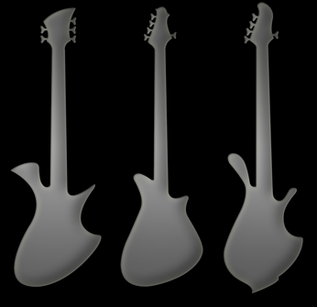
Bass Models
Home->Basses->Models
WaterFall Twiggler Mantis Violin
Notes:
We Have the violin and the bass coming but don’t have a silhouette or pics yet
Text for this page:
Standard Features for all models
1. Availability in all Themes and Footprints.
2. Thru-necks and strings.
3. Chose between BloodWood, Purpleheart, Cocobolo or Ziricote
exotic woods.
4. Wood pickup covers, knobs and bridge (with shimmable saddle),
5. 25 frets (including stainless 0 fret)
6. Fretless available at no extra cost.
7. 16" fretboard radius.
8. Instant trussrod access.
9. Gotoh compact bass tuners.
10. Lindy Fralin passive circuit 'Jazz' style pickups.
11. Available in 30", 32", 34", 35" & 36" scales.
Upgrade Options for all basses
1. Bolt on neck- +$400
2. Stainless frets- +$300
3. Active Bartolini pickup circuit- +$300
(includes PushButton rear access)
4. PushButton rear access (only)- +$100

Slide 17
Waterfall
Home->Basses->Models->Waterfall
Designed by the animated mind of Rob Taylor. This big bass is thick and tight and not for wimps. Expect piano-like tones from this bad boy.
Notes:
Put a larger the silohouette pic as the main pic and the theme pics smaller. Can we add captions to the smaller pics.
We have a pic of an instrument done up in 2 of the themes, for the HighRoller and the LoRyde bass we should use a small silhouette pic with the caption: pic coming soon
Native-Natural mantis 5
LoRyder-Silhouette
Cosmic- bloodwood bass 8x10
HighRoller-silhouette

Slide 18
Twiggler
Home->Basses->Models->LoRyder
Our version of a modern classic. The genetic cousin of the Becker Roller
Full bodied with medium/tight resonance. Deep and twiggly.
Notes:
Put a larger the silohouette pic as the main pic and the theme pics smaller. Can we add captions to the smaller pics.
We have a pic of an instrument done up in 2 of the themes, for the HighRoller and the LoRyde bass we should use a small silhouette pic with the caption: pic coming soon
Native-Natural mantis 5
LoRyder-Silhouette
Cosmic- bloodwood bass 8x10
HighRoller-silhouette

Slide 19
Mantis
Home->Basses->Models->Mantis
Our funkiest design
Well balanced, either strapped on or sitting down
Thin, resonant and light weight for airy tones
Notes:
Put a larger the silohouette pic as the main pic and the theme pics smaller. Can we add captions to the smaller pics.
We have a pic of an instrument done up in 2 of the themes, for the HighRoller and the LoRyde bass we should use a small silhouette pic with the caption: pic coming soon
Native-Natural mantis 5
LoRyder-Silhouette
Cosmic- bloodwood bass 8x10
HighRoller-silhouette

Slide 20
LoRyder
- A colorful instrument with many choices! Satin lacquer finish on
an unaccented thru-neck body constructed of either Mahogany or
RockMaple/Alder. Choose carefully between our vibrant color list and
our 4 exotics (Bloodwood , Purpleheart, Ziricote or Cocobolo) for a look that suits your fancy.
Standard LoRyder features-
1. Satin Lacquer finish, your choice of available colors.
2. Unaccented Mahogany or RockMaple/Alder Body/thruNeck.
3. Bartolini active pickups/circuit.
Upgrades available for the LoRyder-
1. High gloss finish.
Footprint-
Available footprints are numbered from 430 to 636.
Example: A 430 footprint depicts a 4 stringer with a 30" scale.
A 535 footprint depicts a 5 stringer with a 35" scale.
Strings- 4, 5 and 6 string basses are offered standard. Any more or
less may be available by special request.
Scale Length- 30", 32", 34", 35" and 36" are offered as standard scales.
(please note that longer scales are recommended for basses with
a low B string)
Notes:
*eventually there will be many different House photo albums.

Slide 21
Native Theme
Simple Elegance, our most affordable bass. Natural hand-rubbed oil finish on an unaccented Mahogany body with a thru-neck. Fretboard, headplate, pickup covers, wood bridge and knobs in your choice of Bloodwood, Purpleheart, Cocobolo or Ziricote.
Standard Native features-
1. Hand Rubbed Oil finish.
2. Unaccented Mahogany Body/thruNeck.
3. Lindy Fralin passive 'Jazz' style pickups.
Upgrades available for the Native-
1. Hand rubbed Poly topcoat- +$200
2. Active circuit (includes PushButton access)- +$300
3. PushButton rear access (only)- +$100
Footprint-
Available footprints are numbered from 430 to 636.
Example: A 430 footprint depicts a 4 stringer with a 30" scale.
A 535 footprint depicts a 5 stringer with a 35" scale.
Strings- 4, 5 and 6 string basses are offered standard. Any more or
less may be available by special request.
Scale Length- 30", 32", 34", 35" and 36" are offered as standard scales.
(please note that longer scales are recommended for basses with
a low B string)
Notes:
*eventually there will be many different Native photo albums.
Photoalbum caption
Bass natural 1-8 Native Twiggler with Purpleheart
Natural mantis 1-7 Custom Native Mantis with Bloodwood

Slide 22
Cosmic Theme
Boldly accented thru-neck instrument on Curly Maple and finished natural with high-gloss . Accented and embelished with the exotic of your
choice. Bound figured Maple fretboard with matching position
markers. 3pc. exotic wood top, Figured Maple pickup covers, bridge
and knobs. Active Bartolini circuit (standard), Push Button rear
access.
Standard Cosmic features-
1. High gloss lacquer finish.
2. Active Bartolini pickups/circuit with PushButton rear access.
3.
Footprint-
Available footprints are numbered from 430 to 636.
Example: A 430 footprint depicts a 4 stringer with a 30" scale.
A 535 footprint depicts a 5 stringer with a 35" scale.
Strings- 4, 5 and 6 string basses are offered standard. Any more or
less may be available by special request.
Scale Length- 30", 32", 34", 35" and 36" are offered as standard scales.
(please note that longer scales are recommended for basses with
a low B string)
Notes:
*eventually there will be many different cosmic photo albums.
Album caption
Bloodwood bass 1-8 Cosmic Twiggler in Bloodwood

Slide 23
HiRollerTheme
- An intricutely accented Mahogany bodied gem! 9pc. thru-neck, accented 3pc. Curly Maple top. Accented exotic wood pickup covers, bridge and knobs. Exotic headplate and figured Maple bound
exotic fretboard with pearl position markers and emblem.
Standard HiRoller features-
1. Clear high gloss finish.
2. Active Bartolini pickups/circuit with PushButton rear access.
Footprint-
Available footprints are numbered from 430 to 636.
Example: A 430 footprint depicts a 4 stringer with a 30" scale.
A 535 footprint depicts a 5 stringer with a 35" scale.
Strings- 4, 5 and 6 string basses are offered standard. Any more or
less may be available by special request.
Scale Length- 30", 32", 34", 35" and 36" are offered as standard scales.
(please note that longer scales are recommended for basses with
a low B string)
Notes:
*eventually there will be many different House photo albums.

Slide 24
Custom Instruments
Home->Other Instruments->Custom
In addition to our instrument lines, we also do fully custom work. Custom instruments are built to order and pricing will vary based on specifications. These orders have included lap steel guitars, banjos, mandolas, upright basses, and doubleneck mandolin and guitars. If interested in a project of this nature, please inquire.
Notes:
Photo Albums
Custom Guitars Custom Basses Other Custom Instruments
000 LemonLime mantis Ghost mando lin
1 Space bass Grasshopper banjo
4 Waterfall Custom banjo
5 6 string mantis lap steel
6 Retro bass 1-8 Royal crowne mandolin
12
Blueberry Mistress
Caterpiller
Castlewave
King Imperial
Purple P90
Seaburst Ash retro
Seafoam lipstick retro
Zebra mistress
Zias imperial
Mother Earth
Tiger
Origional retro
Mahogany retro

Slide 25
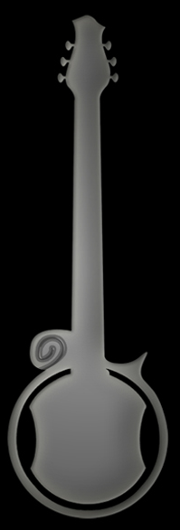
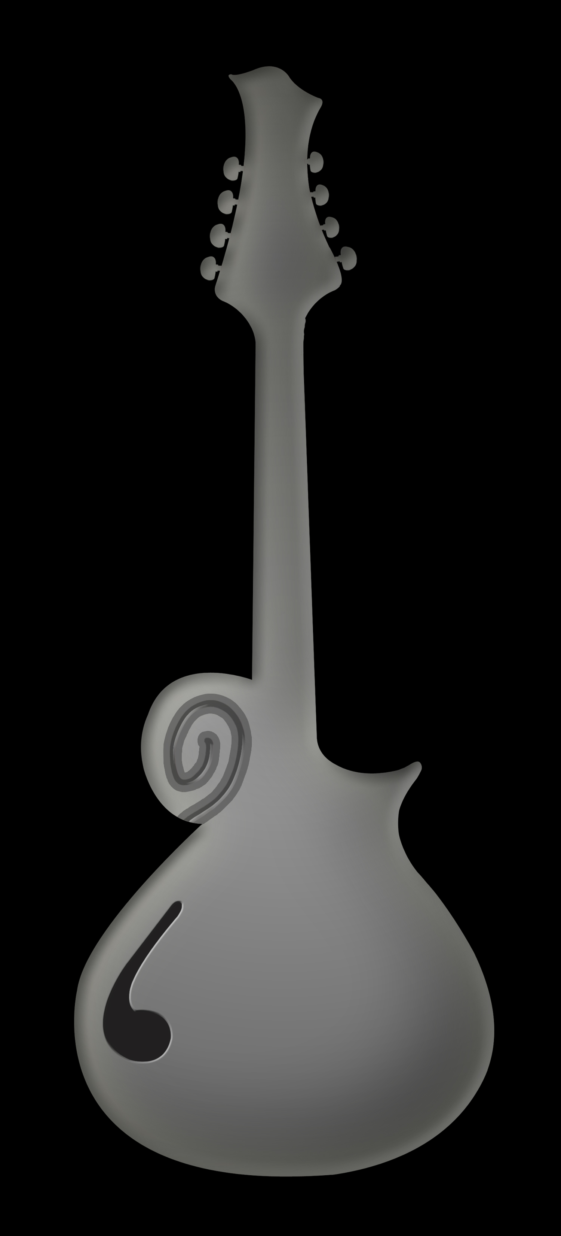
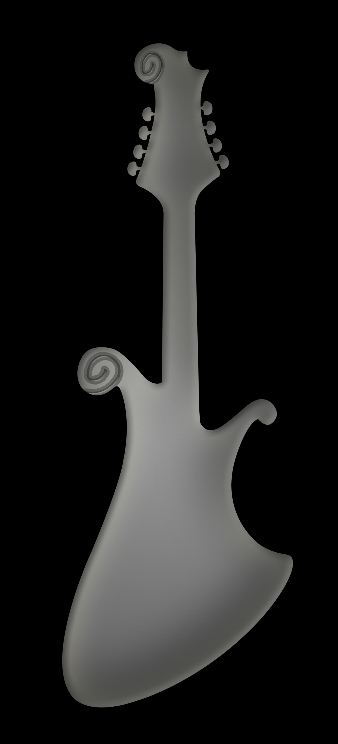
ECL Custom Instruments
Home->Other Instruments
Notes:
We have the 3 random silhouetts. They should all be 1 click button and go to a custom instruments photogallery
Photo Albums
Ghost mando
Grasshopper banjo
Lap steel
Royal crowne mando

Slide 26
Ordering an Instrument
Home->Ordering->How to Order
Our instruments can be ordered by selecting “Add to Cart” from the desired model page. Once an instrument has been added to the cart, themes can be applied and options for specifications can be selected. For fully custom inquiries, please contact by phone or email. Our “Available Now” page features completed instruments ready for purchase as well.

Slide 27
Available Now
Home->Ordering->Available Now
Notes:
This should be a constantly changing photo gallery

Slide 28
About ElectriCandyLand
Home->Resources->About ElectriCandyland
Becker Guitars started as a basement repair shop in 1996. As the business grew, so did our collective interest in producing our own line of high-quality and unique custom instruments. In 2006, we added master luthier and moped aficionado Ryan Martin to our crew and began prototyping and building guitars. We soon outgrew our shop in Stoughton, MA and moved to a fully functional shop in Attleboro, MA. In fall of 2007, we held a booth at the Premier Guitar Festival where we unveiled some of our first designs to the public. The show was a great success, and we have been developing and refining our designs ever since. We are devoted to creating our unique designs that combine superior woodworking techniques, fine and exotic tonewoods, high-quality components, and dazzling finishes. We take a tremendous amount of pride in the work we do and let the instruments speak for themselves. Welcome to ElectriCandyLand.

Slide 29
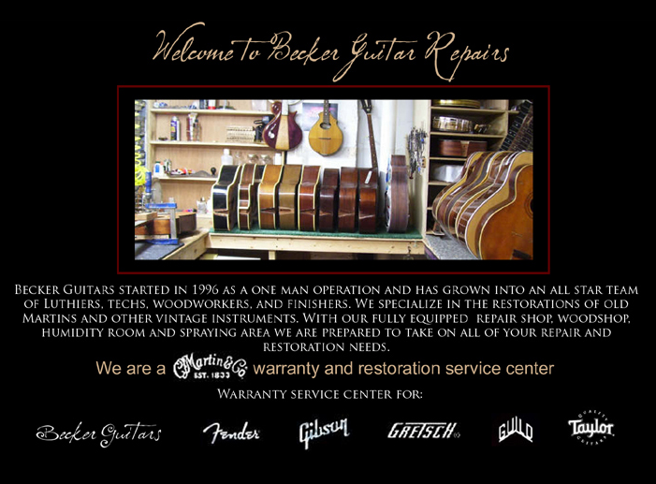
Home->Resources->Repairs
Pricing and services offered: http://www.beckerguitars.com/restoration/Prices.php

Slide 30
ElectriCandyland Artists
Home->Resources->ElectriCandyland Artists
Jon Gutwillig (the Disco Biscuits)
Jake Cinninger (Umphrey’s McGee)
Chuck Garvey (moe.)
Marc Brownstein (the Disco Biscuits)
Ryan Stasik (Umphrey’s McGee)
Mihali Savoulidis (Twiddle)
Dave Drouin (The Brew)
Justin Hasting (Zoogma)
Andrew Provine (AV8R)
Patrick Hayes
Kevin MacKenzie (The Few)
Jeff Lawson (ChainDrive)
Rob Taylor
Notes:
Clicking an artist name will take you to a bio page with info on their instruments, band information, etc

Slide 31
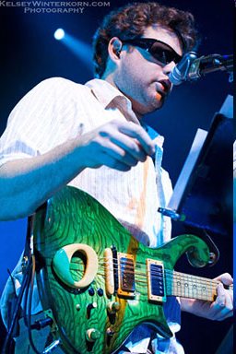
Jon Gutwillig
Home->Resources->ElectriCandyland Artists-> Jon Gutwillig
Lead guitarist and vocalist for electronic/jam band the Disco Biscuits, Jon is our longest-standing artist. He has been playing our instruments since we first met in 2008. Jon uses a custom MIDI Imperial A P90 GhostRider as well as several Rollers and Mistresses.
Pictures:
Video:
www.thediscobiscuits.com

Slide 32
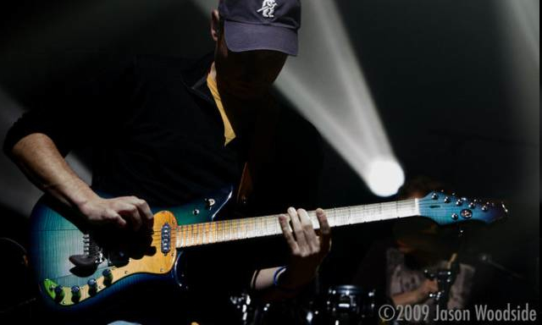
Jake Cinninger
Home->Resources->ElectriCandyland Artists->Jake Cinninger
Jake plays lead guitar for progressive jam band Umphrey’s McGee. We met the band in 2008, and Jake has played a variety of our guitars since. In 2009 we finished his fully custom Roller, “Mother Earth.”
Pictures:
Video:
www.umphreys.com.

Slide 33
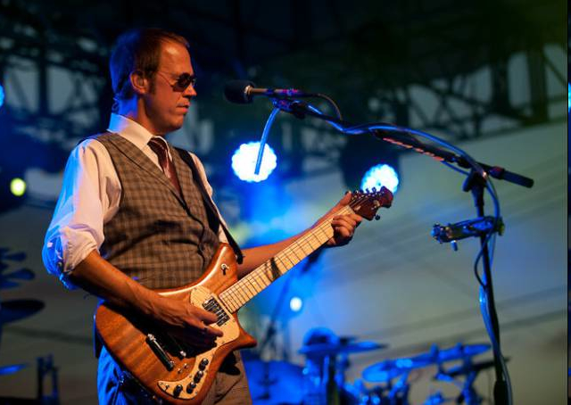
Chuck Garvey
Home->Resources->ElectriCandyland Artists->Chuck Garvey
Chuck is the lead guitarist from prog rockers/jam band moe. He has been playing our guitars since 2010. Right now, Chuck plays two GhostRider Rollers, one with P90s and one with humbuckers.
Pictures:
Video:
www.moe.org

Slide 34
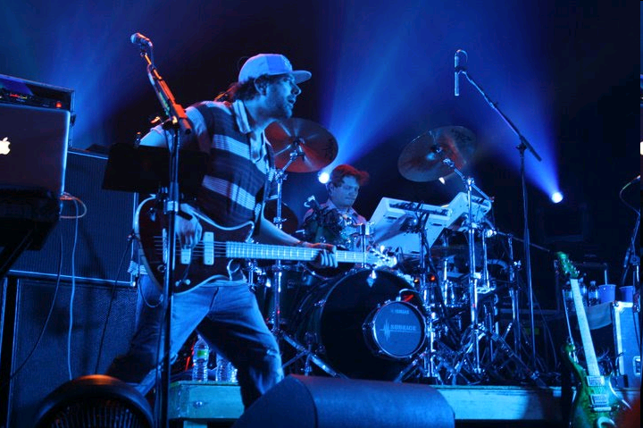
Marc Brownstein
Home->Resources->ElectriCandyland Artists->Marc Brownstein
Marc Brownstein plays bass for the Disco Biscuits. He has played several of our basses since 2008. He is currently playing a LoRyder bass.
Pictures:
Video:
www.thediscobiscuits.com

Slide 35
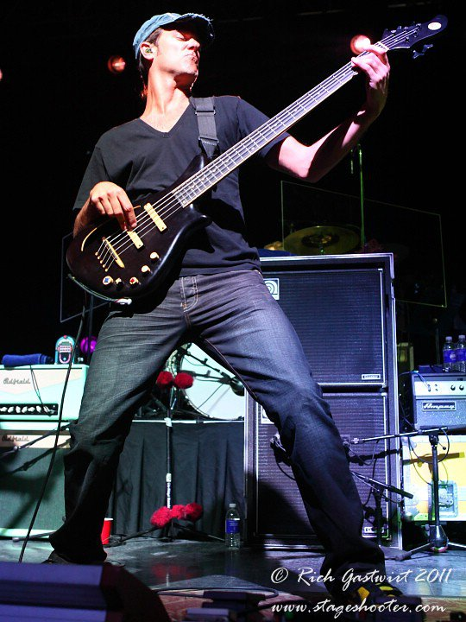
Ryan Stasik
Home->Resources-ElectriCandyland Artists->Ryan Stasik
Bassist for Umphrey’s McGee, Ryan has been a RMB artist since early 2011. He plays a custom LoRyder bass.
Pictures:
Video:
www.umphreys.com

Slide 36
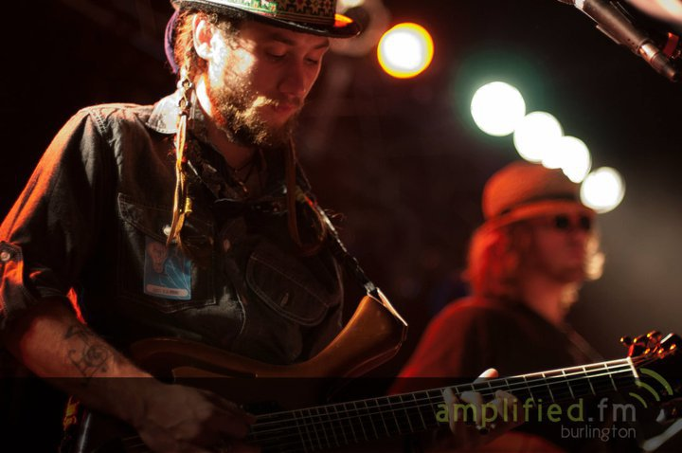
Mihali “Mickey” Savoulidis
Home->Resources-ElectriCandyland Artists->Mihali Savoulidis
Mickey plays guitar in Vermont-based jam band Twiddle. He has played a variety of Hornets since 2010.
Pictures:
Video:
www.twiddle.com

Slide 37
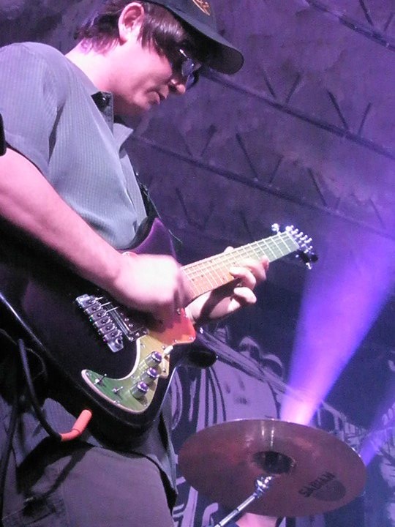
Justin Hasting
Home->Resources->ElectriCandyland Artists->Justin Hasting
Justin is the guitar player for electronic/rock group Zoogma. He has been using our instruments since 2009. He currently plays a custom GhostRider Roller.
Pictures:
Video:
www.zoogma.net

Slide 38
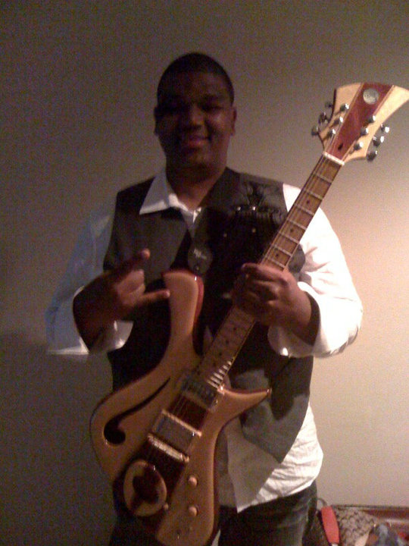
Patrick Hayes
Home->Resources->ElectriCandyland Artists->Patrick Hayes
Pat is a platinum R&B producer and has played guitar for groups including B.B. King, The Black Eyed Peas, and R. Kelly. He has been using a Becker Hornet since 2009.
Pictures:
Video:www.facebook.com/patrickguitarboy

Slide 39
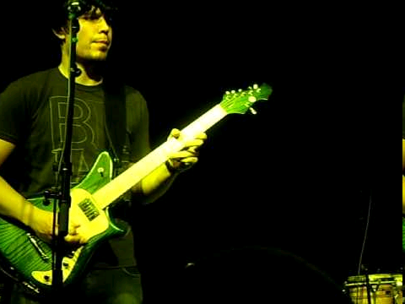
Dave Drouin
Home->Resources->ElectriCandyland Artists->Dave Drouin
Dave plays guitar in Boston-based indie rock band The Brew. He has played our instruments since 2009. He has performed with a GhostRider Roller and a HeadHunter Imperial.
Photos:
Video:
www.thebrew.biz

Slide 40
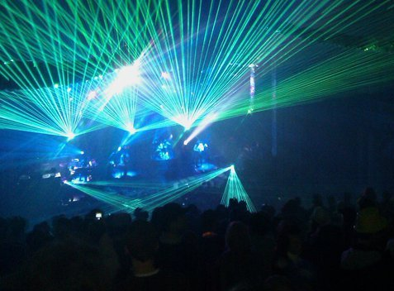
Andrew Provine
Home->Resources->ElectiCandyland Artists->Andrew Provine
Andrew Provine is AV8R, a one-man electronic/DJ/live guitar act. He’s been a Becker artist since 2011. Andrew plays a HeadHunter CastleWave with all MIDI electronics.
Pictures:
Video:
www.myspace.com/prosizzle

Slide 41
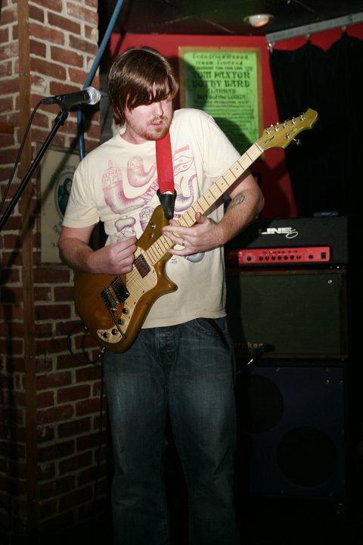
Kevin MacKenzie/Ryan Martin (of The Few)
Home-Resources->ElectriCandyland Artists->Kevin MacKenzie
Kevin and Ryan make up the string section of Boston based VintageRock band The Few. Kevin was introduced to our line in 2009, shortly after meeting Ryan. Magic was once again crafted and today Kevin plays a GhostRider Roller known as ‘Granny Smith’. Ryan’s flavor of the week is a custom 6 string Mantis.
Pictures:
Video:www.thefewmusic.net

Slide 42
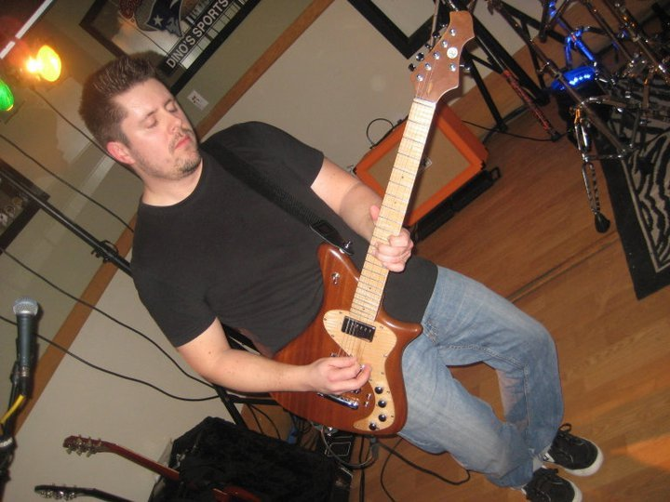
Jeff Lawson
Home->Resources->ElectriCandyland Artists->Jeff Lawson
Jeff plays guitar in alternative rock band ChainDrive. He has been a Becker artist since 2011. He plays a GhostRider Roller.
Pictures:
Video:
www.chaindriverocks.com

Slide 43
Rob Taylor
Home->Resources->ElectriCandyland Artists->Rob Taylor
Rob Taylor is a pop singer/songwriter from Connecticut. He has been playing Becker Guitars since
2007 and owns several instruments including 6 string guitars, basses, a mandolin and an electric Banjo.
Becker instruments and Ryan Martin Basses can be heard throughout his albums, “Sun in a Box”, “Come
Down Never”, and his upcoming release, ”Imperfectly Sound”.
like him on facebook:
http://www.facebook.com/#!/pages/Rob-Taylor/128104770662
www.robtaylor.com

Slide 44
Contact
Home->Resources->Contact
Becker Guitars
44A Union Street
Attleboro, MA 02703
Phone: (508)222-9800
Fax: (508)9801
Email: beckerguitars@gmail.com
www.facebook.com/beckerguitars
Notes:
Can you also add : like us on Facebook at http://www.facebook.com/ElectriCandyLand

Slide 45
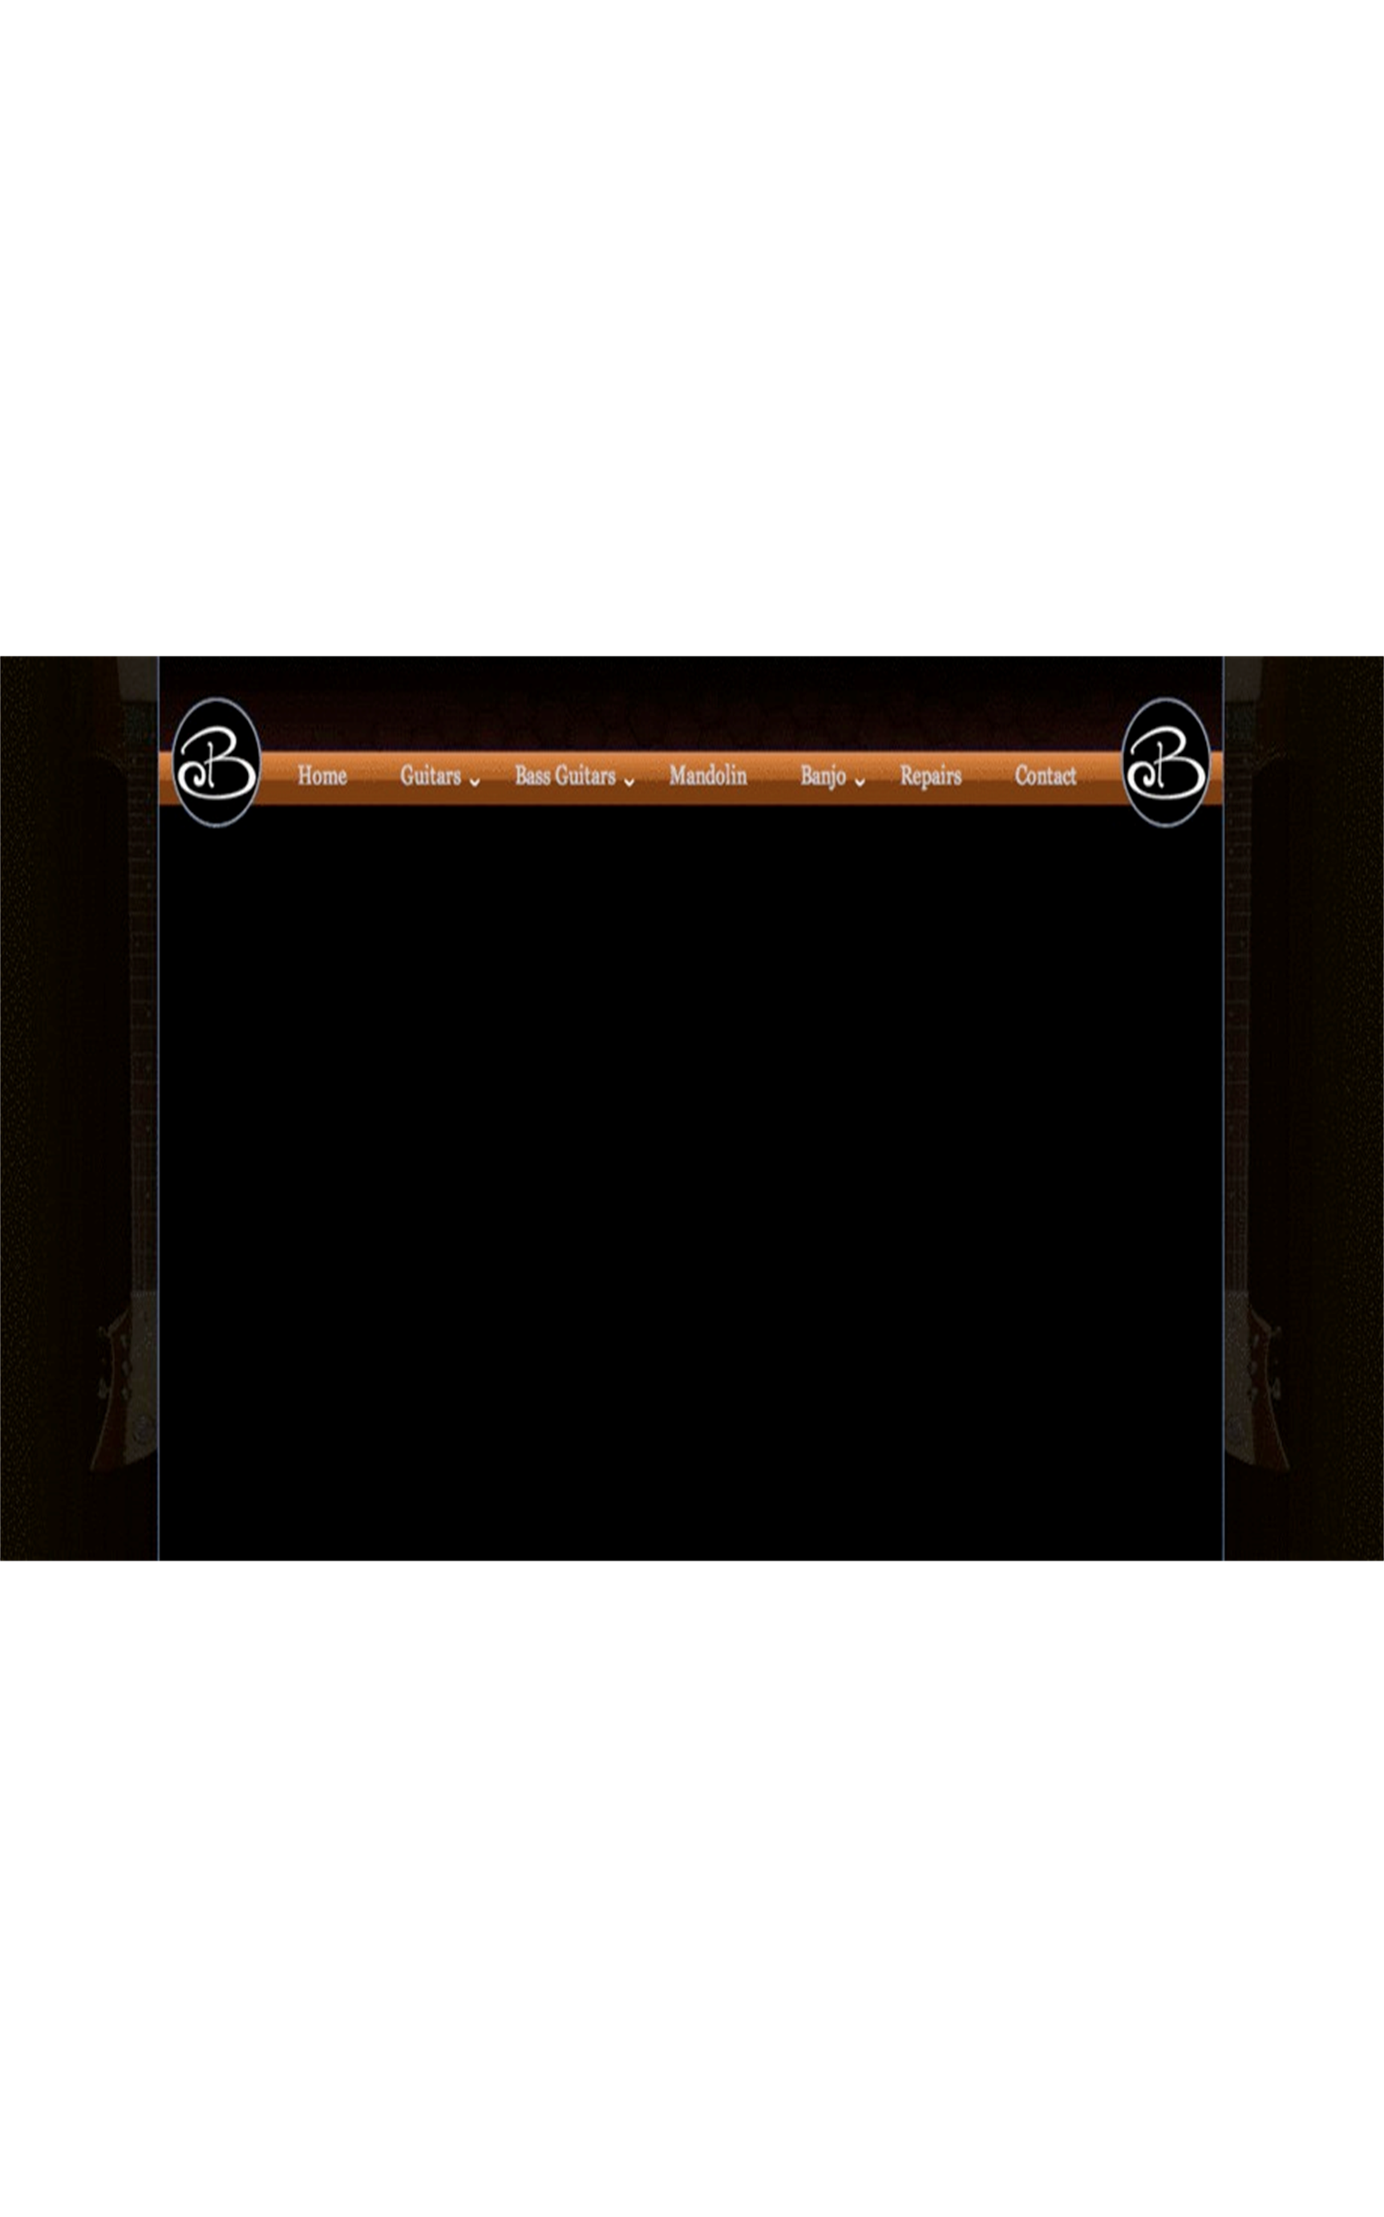
Instrument Gallery
This page will contain all photos from the Guitar, bass, Mandolin, and Custom pages
Photos should be laid out in albums by instrument
Each instrument needs to be properly labeled (see notes section for “Instrument Name: File Name” layout)
Notes:
Natural Mantis: natural mantis 1-7
Natural LoRyder: Bass natural 1-6 & 8
HeadHunter Roller: Redburst HeadHunter 1-8
HeadHunter Roller: Stormburst Roller 1-7
HeadHunter Imperial: Blackberry HeadHunter 1-7
HeadHunter Castlewave: MIDI Castlewave 1-7
House Roller: Jetson 1-9, no 8x10
House Roller: House Roller 1-7
House Imperial: House Imperial 1 & 3
House Imperial: Kaplan Imperial 1-8
House Mistress: Purple Mistress 1-8
House Dark Horse: Dark Horse 1-8
Nashville Roller: Nashville Roller 1-13, no 8x10
Royal Crown Mandolin: Royal Crown 1-4 & 6-10
Ghost Mandolin: Ghost 1-6
Jake Cinninger’s Custom “Mother Earth” Roller: Mother Earth 1-7
Custom Imperial: King 1-9, no 8x10
Custom Imperial: Zias 1-8
Custom Mistress: Blueberry 1-7
Custom Mistress: Zebra Mistress 1, 2, 3, & 9
Custom Waterfall Bass: Purple waterfall 1-9, no 8x10, include “purple waterfall in case.jpg”
Custom Waterfall Bass: Waterfall 1-7
Custom LoRyder: bloodwood bass 1-8
Custom Mantis: Lemon Lime Mantis 1-10
Custom Lap Steel: Lap Steel 1-4
Custom Banjo: Grasshopper 1-11, no 8x10

Slide 46

Prototypes and Discontinued Models Gallery
This page will be set up identical to our Instrument Gallery Page, but will feature prototypes and discontinued models
Notes:
Mistress Serial Number 000: 000-1 thru 000-11 except 000-7
Imperial Serial Number 001: 1 #1 thru 1 #10 except 1 #8
Mistress Serial Number 004: 4 #1 thru 4 #10 except 4 #8, include 4 vertical
Imperial Prototype: 5 #1 thru 5 #10, no 8x10
Mistress Prototype: 6 #1 thru 6 #10 except 6 #8
Roller Prototype: 12 #1 thru 12 #10 except 12 #8
Hornet Prototype: 18 #1 thru 18 #10 except 18 #8
Banjo Prototype: Banjo #1 thru Banjo #13 except Banjo #8
Original Retro Roller: Original Retro 1-11, no 8x10
Retro Roller: Seaburst Retro 1-7
Retro Roller: Mahogany Retro 1-7

